Slide 1
Tutorial 4 - Supplements for Lecture 4 notes

Slide 2
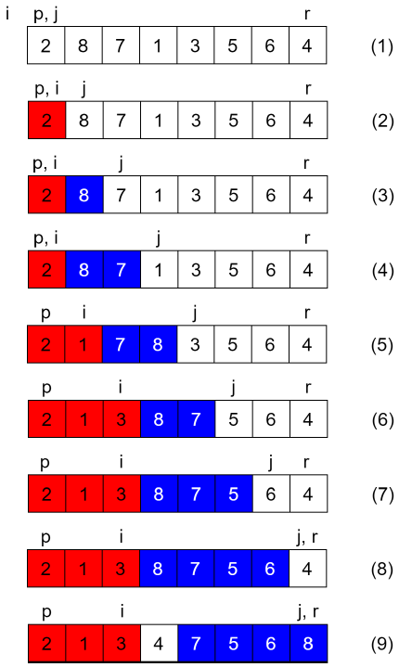
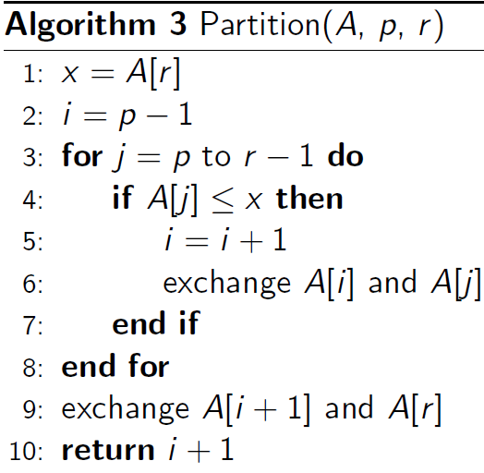

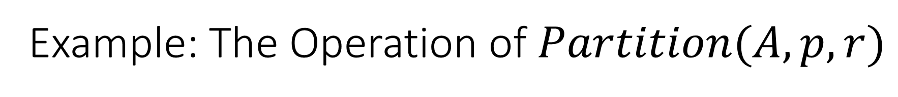
Example: The Operation of $Partition(A, p, r)$
The detailed intermediate steps?

Slide 3



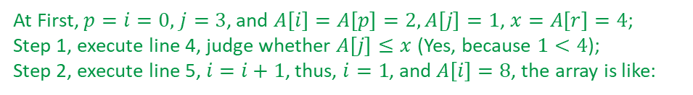

Example: The Operation of $Partition(A, p, r)$
At First, $p=i=0,$ $j=3$, and $A\left[i\right]=A\left[p\right]=2, A\left[j\right]=1$, $x=A\left[r\right]=4$;
Step 1, execute line 4, judge whether $A\left[j\right]≤x$ (Yes, because $1<4$);
Step 2, execute line 5, $i=i+1$, thus, $i=1$, and $A\left[i\right]=8$, the array is like:
$p$ $i$ $j$
2 | 8 | 7 | 1 | 3 | 5 | 6 | 4
Step 3, execute line 6, exchange $A[i]$ and $A[j]$, that is to exchange the element $8$ and $1$, the array will be like:
$p$ $i$ $j$
2 | 1 | 7 | 8 | 3 | 5 | 6 | 4
Step 4, execute line 3, $j++$, then $j=4$, the array will be like:
$p$ $i$ $j$
2 | 1 | 7 | 8 | 3 | 5 | 6 | 4

Slide 4
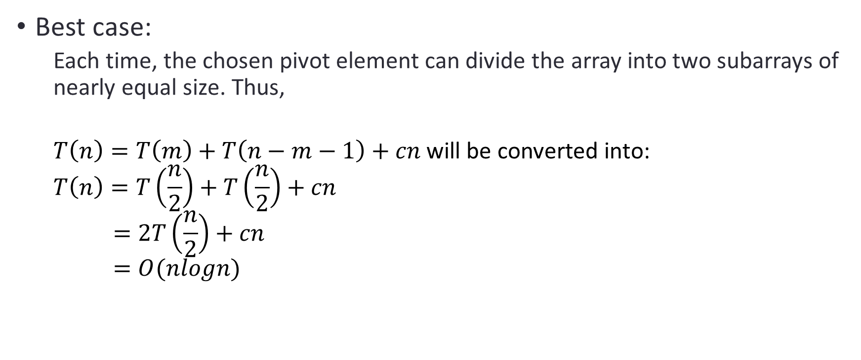
Time cost of Quick-Sort
Best case:
Each time, the chosen pivot element can divide the array into two subarrays of nearly equal size. Thus,
$T\left(n\right)=T\left(m\right)+T\left(n−m−1\right)+cn$ will be converted into:
$$T\left(n\right)=T\left(\frac{n}{2}\right)+T\left(\frac{n}{2}\right)+cn$$
$$=2T\left(\frac{n}{2}\right)+cn$$
$$=O(nlogn)$$

Slide 5
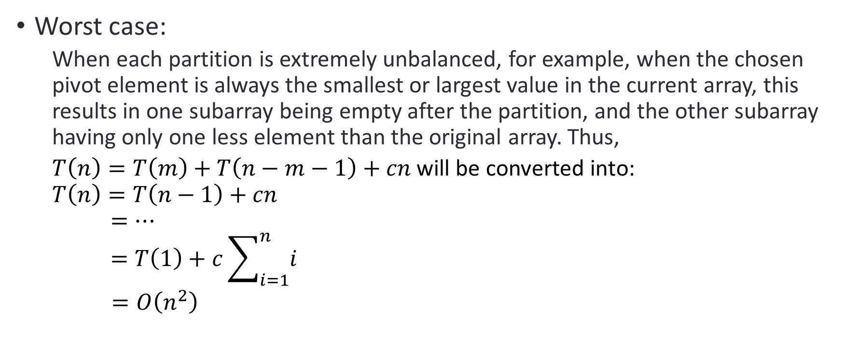
Time cost of Quick-Sort
Worst case:
When each partition is extremely unbalanced, for example, when the chosen pivot element is always the smallest or largest value in the current array, this results in one subarray being empty after the partition, and the other subarray having only one less element than the original array. Thus,
$T\left(n\right)=T\left(m\right)+T\left(n−m−1\right)+cn$ will be converted into:
$$T\left(n\right)=T\left(n−1\right)+cn$$
$$=⋯$$
$$=T\left(1\right)+c\sum_{i=1}^{n}{i}$$
$=O\left(n^{2}\right)$

Slide 6
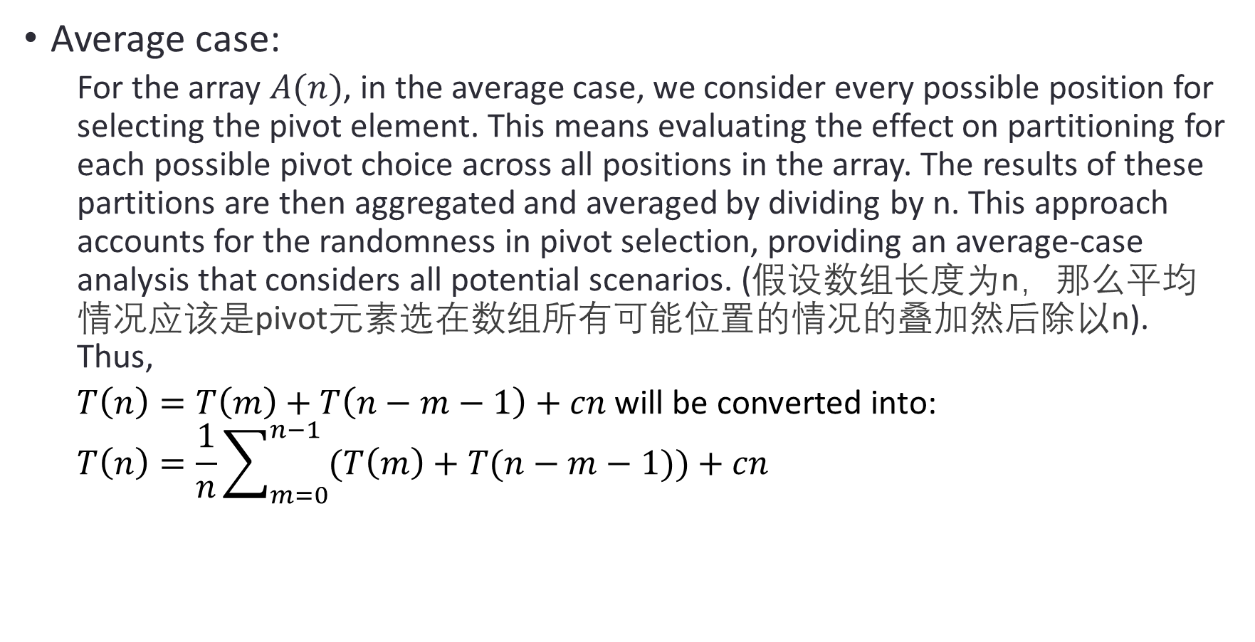
Time cost of Quick-Sort
Average case:
For the array $A(n)$, in the average case, we consider every possible position for selecting the pivot element. This means evaluating the effect on partitioning for each possible pivot choice across all positions in the array. The results of these partitions are then aggregated and averaged by dividing by n. This approach accounts for the randomness in pivot selection, providing an average-case analysis that considers all potential scenarios. (假设数组长度为n，那么平均情况应该是pivot元素选在数组所有可能位置的情况的叠加然后除以n). Thus,
$T\left(n\right)=T\left(m\right)+T\left(n−m−1\right)+cn$ will be converted into:
$$T\left(n\right)=\frac{1}{n}\sum_{m=0}^{n−1}{(T\left(m\right)+T(n−m−1))}+cn$$

Slide 7
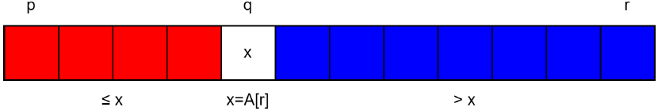
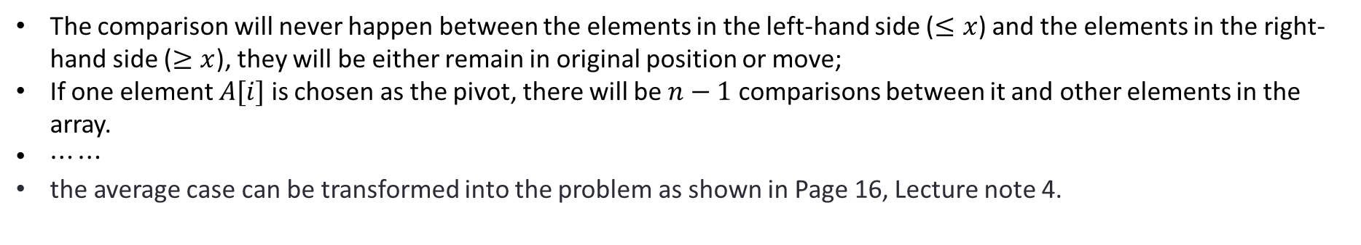
Time cost of Quick-Sort
Average case:
No matter what the pivot is, the result after one iteration of partition will be like:
The comparison will never happen between the elements in the left-hand side ($≤x$) and the elements in the right-hand side ($≥x$), they will be either remain in original position or move;
If one element $A[i]$is chosen as the pivot, there will be $n−1$ comparisons between it and other elements in the array.
$⋯⋯$
the average case can be transformed into the problem as shown in Page 16, Lecture note 4.

Slide 8
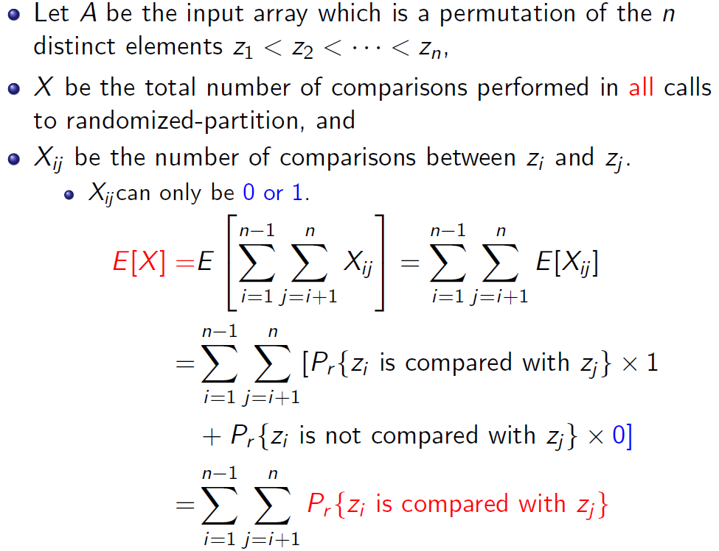
Time cost of Quick-Sort
Average case:

Slide 9
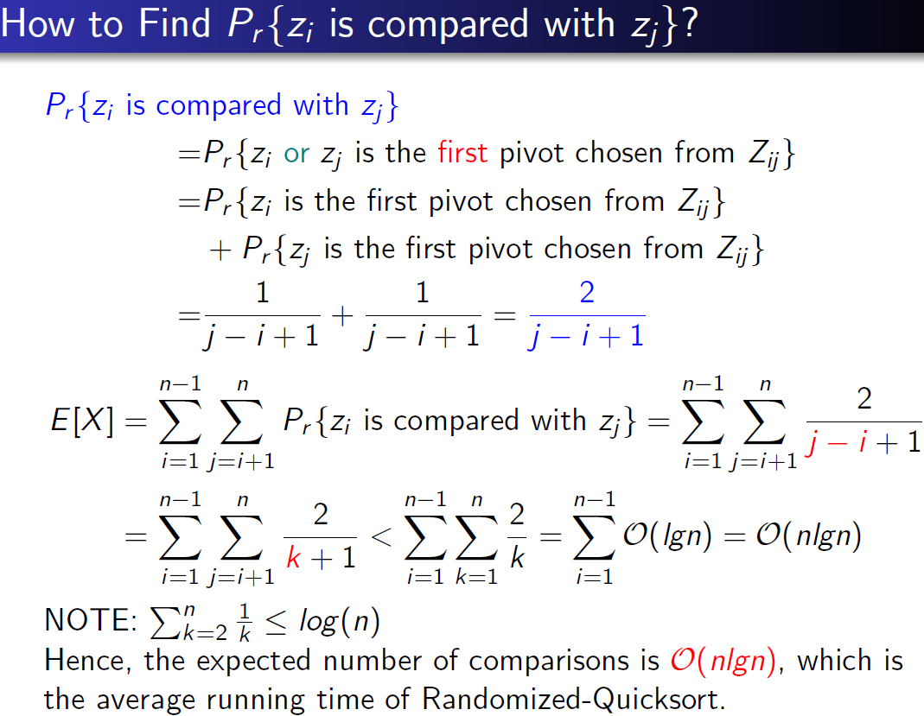
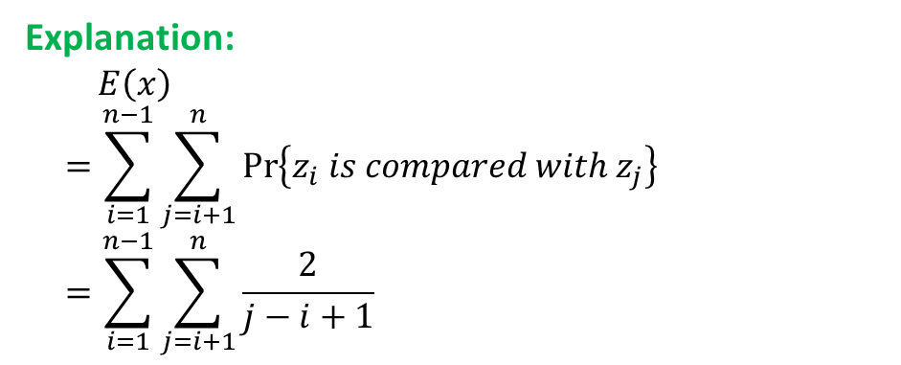
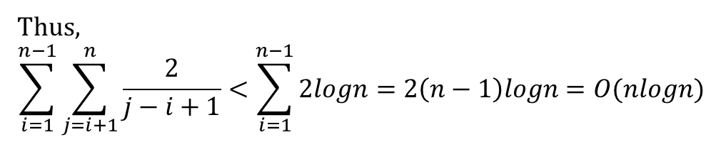
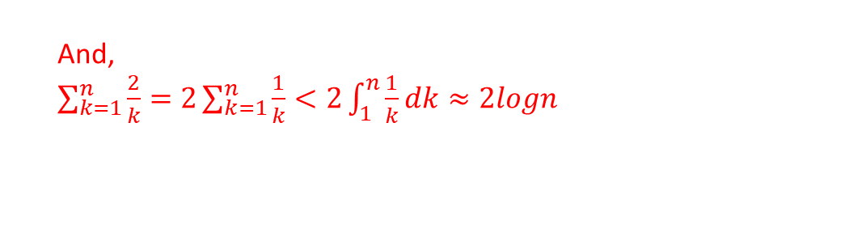
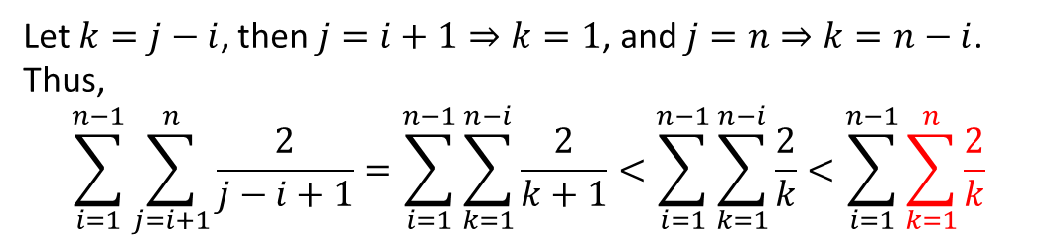
Time cost of Quick-Sort
Explanation:
$$E\left(x\right)=\sum_{i=1}^{n−1}{\sum_{j=i+1}^{n}{\operatorname{Pr}\left\{z_{i} is compared with z_{j}\right\}}} =\sum_{i=1}^{n−1}{\sum_{j=i+1}^{n}{\frac{2}{j−i+1}}}$$
Average case:
Let $k=j−i$, then $j=i+1⇒k=1$, and $j=n⇒k=n−i$. Thus,
$$\sum_{i=1}^{n−1}{\sum_{j=i+1}^{n}{\frac{2}{j−i+1}}}=\sum_{i=1}^{n−1}{\sum_{k=1}^{n−i}{\frac{2}{k+1}}}<\sum_{i=1}^{n−1}{\sum_{k=1}^{n−i}{\frac{2}{k}}<\sum_{i=1}^{n−1}{\sum_{k=1}^{n}{\frac{2}{k}}}}$$
And,
$\sum_{k=1}^{n}{\frac{2}{k}}=2\sum_{k=1}^{n}{\frac{1}{k}}<2\int_{1}^{n}{\frac{1}{k}dk}≈2logn$
Thus,
$$\sum_{i=1}^{n−1}{\sum_{j=i+1}^{n}{\frac{2}{j−i+1}}}<\sum_{i=1}^{n−1}{2logn}=2\left(n−1\right)logn=O(nlogn)$$

Slide 10
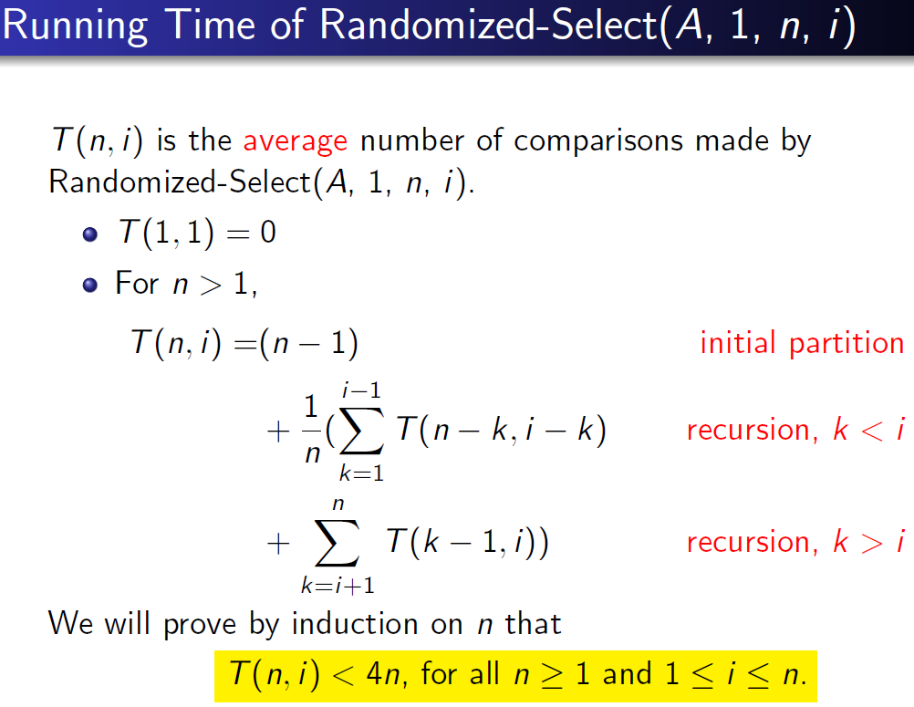
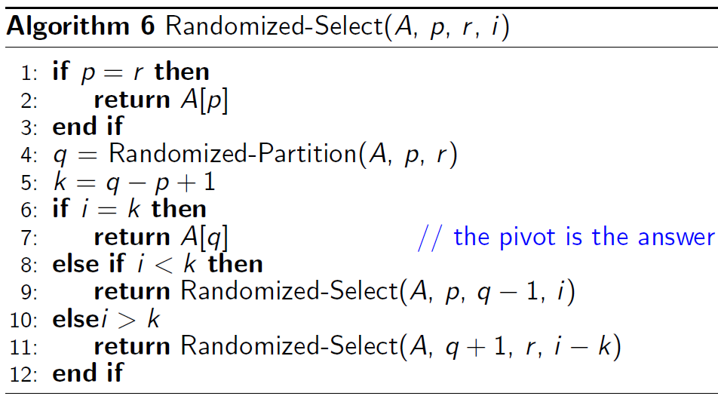
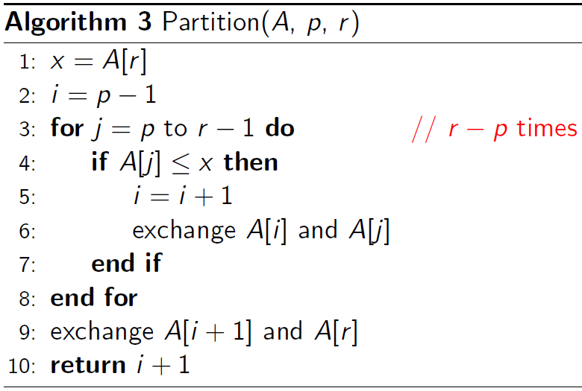
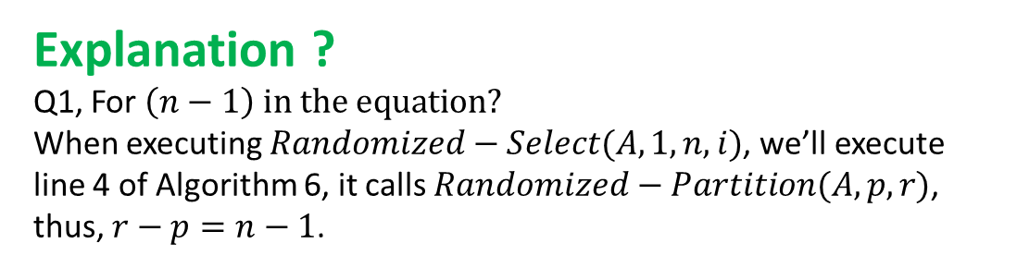
Random Selection
Explanation ?
Q1, For $\left(n−1\right)$ $in the equation?$
When executing $Randomized−Select(A,1,n,i)$, we’ll execute line 4 of Algorithm 6, it calls $Randomized−Partition(A,p,r)$, thus, $r−p=n−1$.

Slide 11
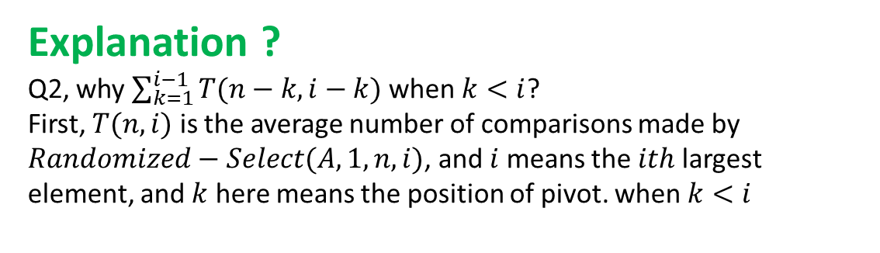
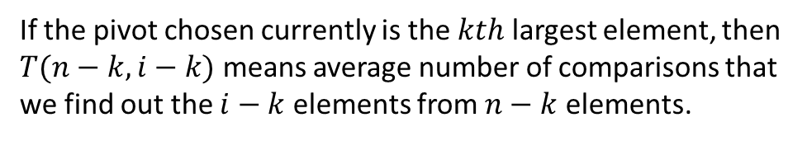

Random Selection
Explanation ?
Q2, why $\sum_{k=1}^{i−1}{T(n−k,i−k)}$ when $k<i$?
First, $T(n,i)$ is the average number of comparisons made by $Randomized−Select(A,1,n,i)$, and $i$ means the $ith$ largest element, and $k$ here means the position of pivot. when $k<i$
Postion: $1$ $k$ (Pivot) $i$ $n$
If the pivot chosen currently is the $kth$ largest element, then $T(n−k,i−k)$ means average number of comparisons that we find out the $i−k$ elements from $n−k$ elements.

Slide 12
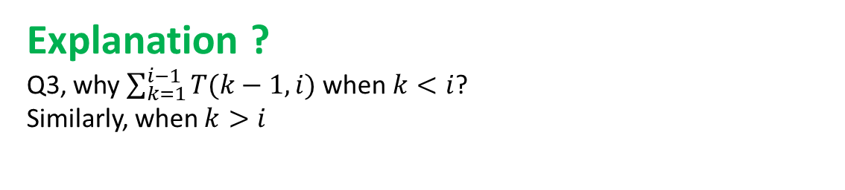
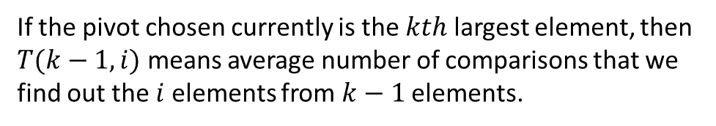

Random Selection
Explanation ?
Q3, why $\sum_{k=1}^{i−1}{T(k−1,i)}$ when $k<i$?
Similarly, when $k>i$
Postion: $1$ $i$ $k$ (Pivot) $n$
If the pivot chosen currently is the $kth$ largest element, then $T(k−1,i)$ means average number of comparisons that we find out the $i$elements from $k−1$ elements.

Slide 13
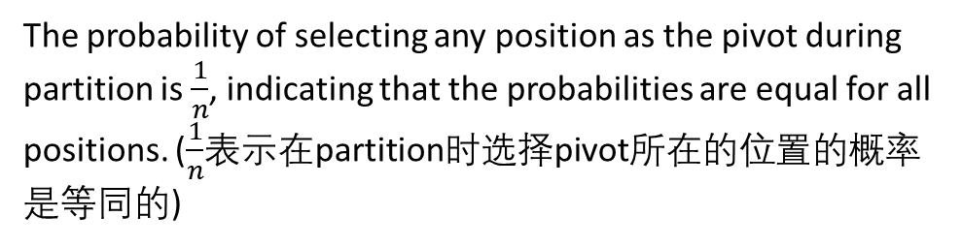
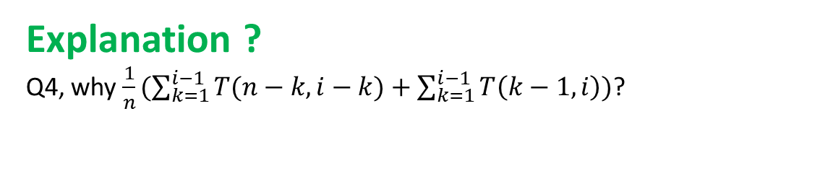
Random Selection
Explanation ?
Q4, why $\frac{1}{n}(\sum_{k=1}^{i−1}{T(n−k,i−k)}+\sum_{k=1}^{i−1}{T\left(k−1,i\right)})$?
The probability of selecting any position as the pivot during partition is $\frac{1}{n}$, indicating that the probabilities are equal for all positions. ($\frac{1}{n}$表示在partition时选择pivot所在的位置的概率是等同的)

Slide 14
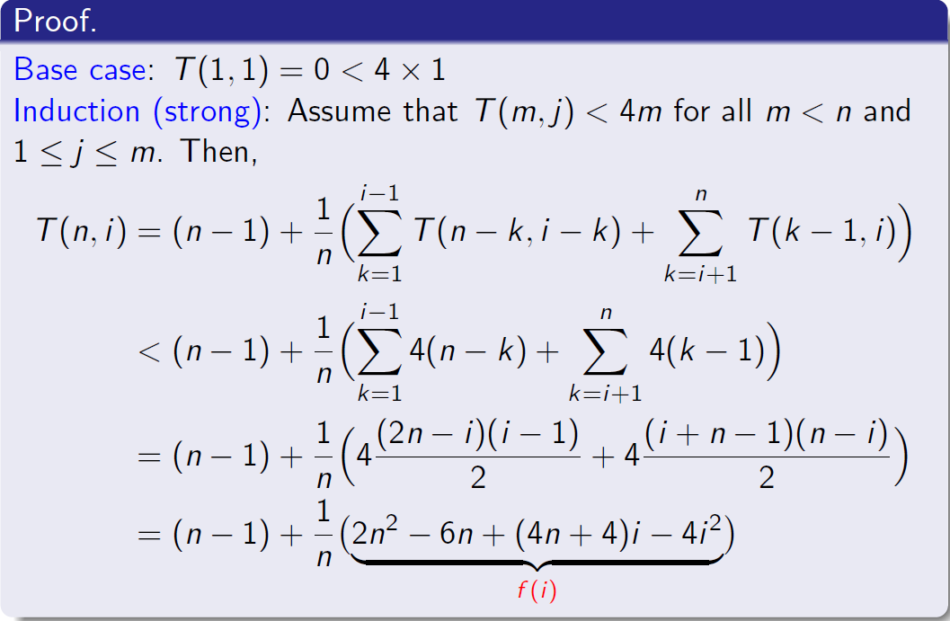
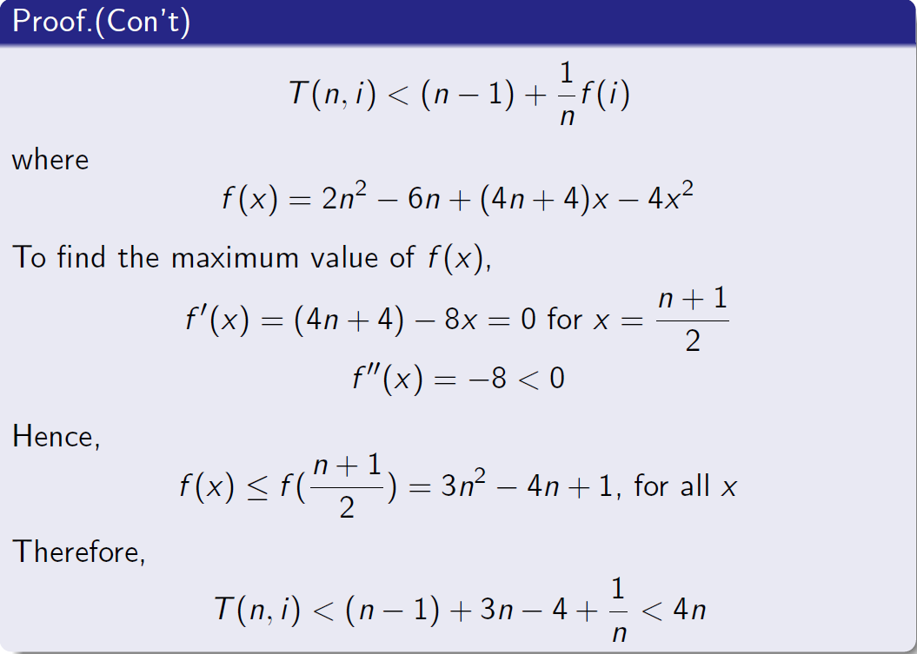

Random Selection
Prove the conclustion: $T(n,i)<4n$, for all $n>=i$ and $1≤i≤n$by mathematical induction.

